Slide 1

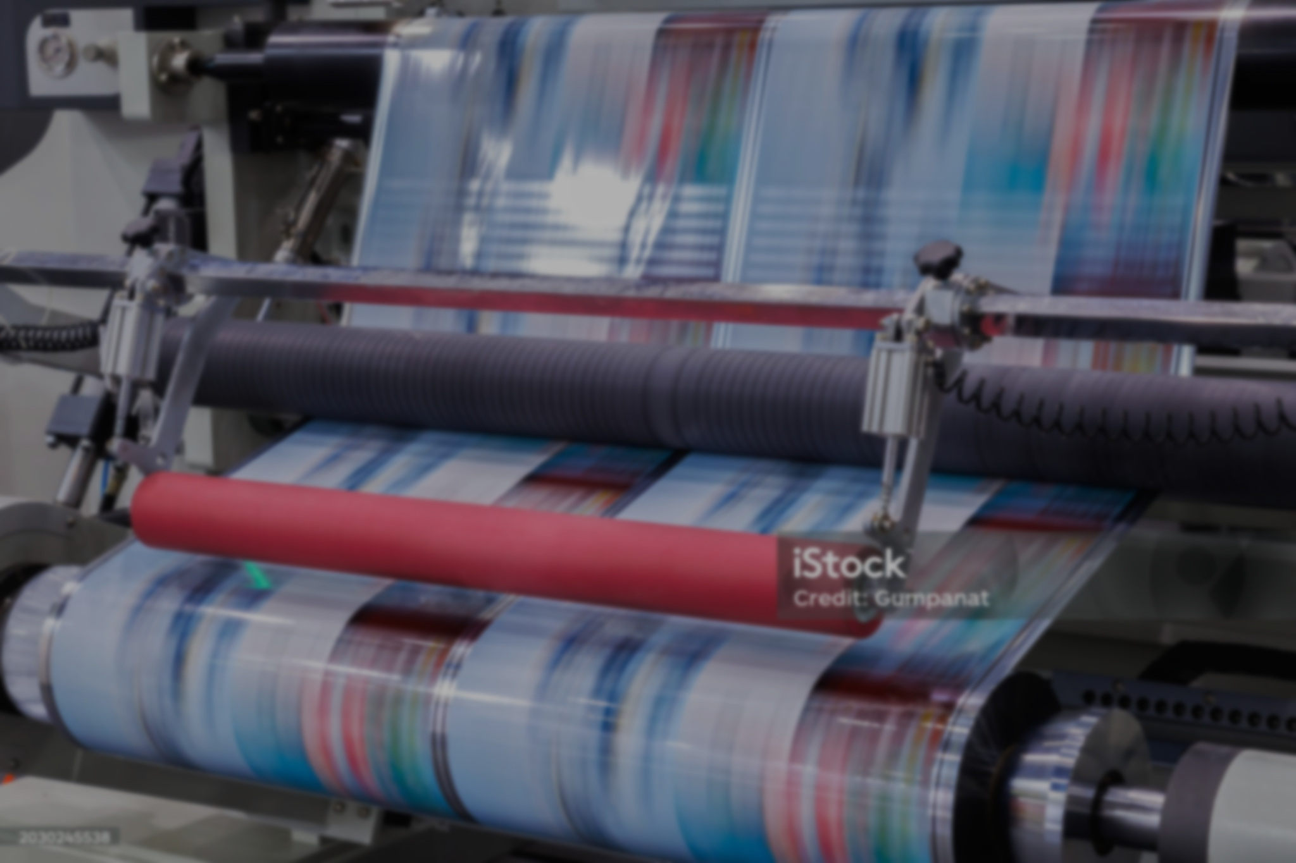










Alwan Modern Printing Press
Presentation
Manual user
Team members
Sameh Ahmed Ahmed Mohmed Saad Fady Hanna
Mahmoud Abdallah Youssef Mohamed

Slide 2

Introduction
“ Alwan” Printing Press is a medium-sized project launched on January 1, 2024.
Built on 1,600 sqm with dedicated production and administration areas.
Equipped with modern printing systems to ensure high efficiency and meet diverse customer needs with top quality.

Slide 3
Introduction
“ Alwan” Printing Press is a medium-sized project launched on January 1, 2024.
Built on 1,600 M² with dedicated production and administration areas.
Equipped with modern printing systems to ensure high efficiency and meet diverse customer needs with top quality.

Slide 4
Analysis
Gap
Met with each department manager to understand their work and identify common challenges.
Discussed expectations for the new system (Odoo V18 ERP) to improve efficiency and ease of work.

Slide 5
Analysis
Gap
WE Met with each department manager to understand their work and identify common challenges.
Discussed expectations for the new system (Odoo V18 ERP) to improve efficiency and ease of work.

Slide 6
FIRST
Warehouse
Management
Manual item placement leads to misplacement and stock inaccuracies.
Proposed Solution: Activate Putaway Rules in Odoo to automatically direct received items to their designated storage locations.

Slide 7
FIRST
Warehouse
Management
Manual item placement leads to misplacement and stock inaccuracies.
Proposed Solution: activate putaway rules in Odoo to automatically direct received items to their designated storage locations.

Slide 8
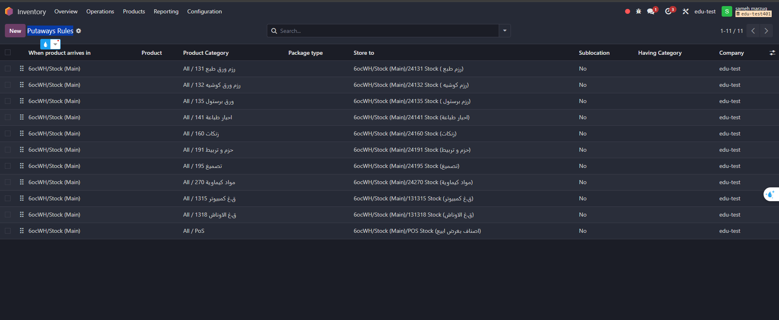
FIRST
Warehouse
Management
Create putaway rules to link each Product Category to each specific location

Slide 9
FIRST
Warehouse
Management
Create putaway rules to link each Product Category to each specific location

Slide 10

SECOND :
Paper Stock
Summary
Accurate recording of paper stocks is critical for operations.
Paper is purchased by weight for better pricing and availability.
Issuing is done in packages, not by weight.
Unit conversion may cause human errors affecting stock accuracy.

Slide 11
SECOND :
Paper Stock
Summary
Accurate recording of paper stocks is critical for operations.
Paper is purchased by weight for better pricing and availability.
Issuing is done in packages, not by weight.
Unit conversion may cause human errors affecting stock accuracy.

Slide 12
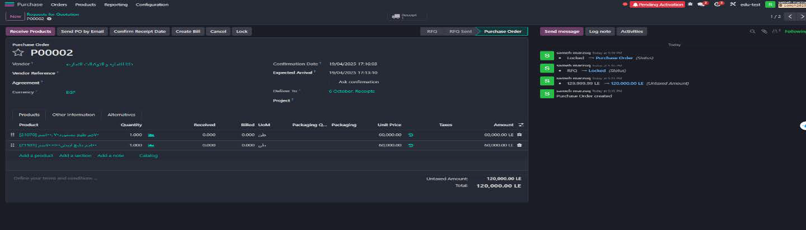
SECOND 1:
Paper Stock
Summary
The system will handle purchasing and disbursement automatically using accurate units like tons and sheet packages.

Slide 13
SECOND 1:
Paper Stock
Summary
The system will handle purchasing and disbursement automatically using accurate units like tons and sheet packages.

Slide 14
SECOND 2:
Paper Stock
Summary
The system will handle purchasing and disbursement automatically using accurate units like tons and sheet packages.

Slide 15
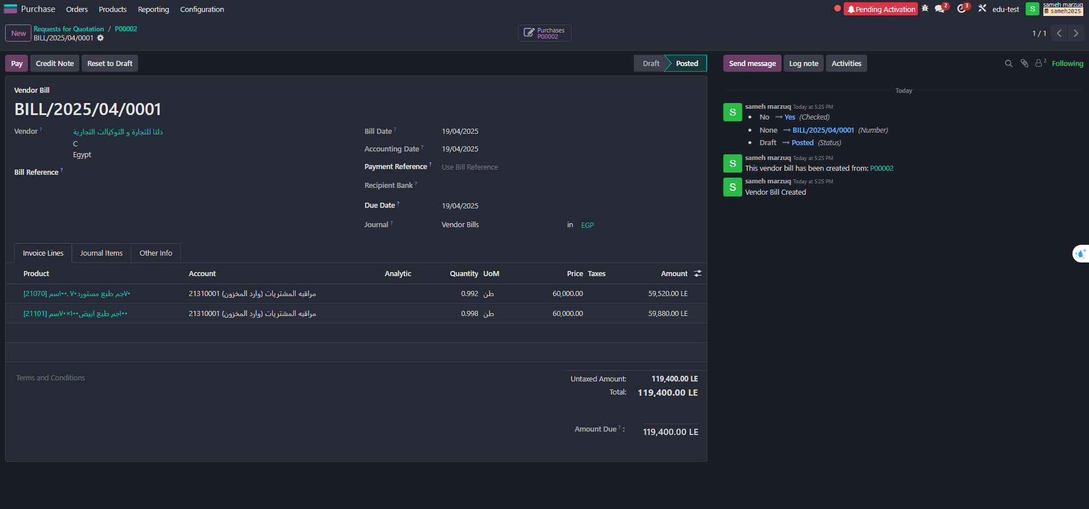
SECOND 2:
Paper Stock
Summary
It will convert between weight and packages without manual work, reducing errors and keeping stock accurate.

Slide 16
Third:
Internal
Transfer
Visibility
The client requested to display internal transfers between warehouses, along with the related transfer documents.
Proposed Solution: To improve internal movement of materials and save time, route was created in Inventory app to handle internal transfer.

Slide 17
Third:
Internal
Transfer
Visibility
The client requested to display internal transfers between warehouses, along with the related transfer documents.
Proposed Solution: To improve internal movement of materials and save time, route was created in Inventory app to handle internal transfer.

Slide 18
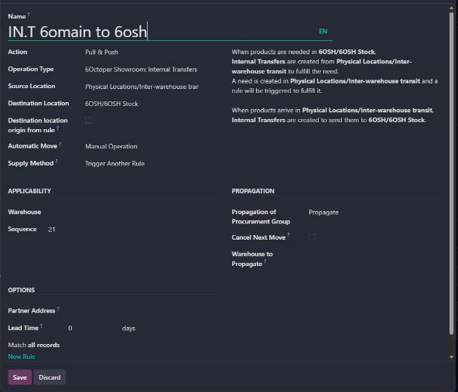
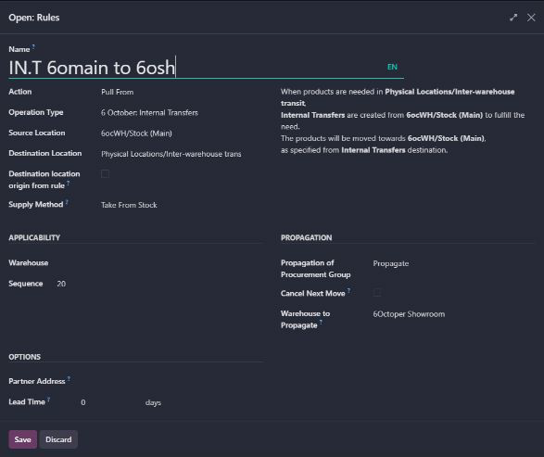
Third:
Internal
Transfer
Visibility 1

Slide 19
Third:
Internal
Transfer
Visibility 1

Slide 20
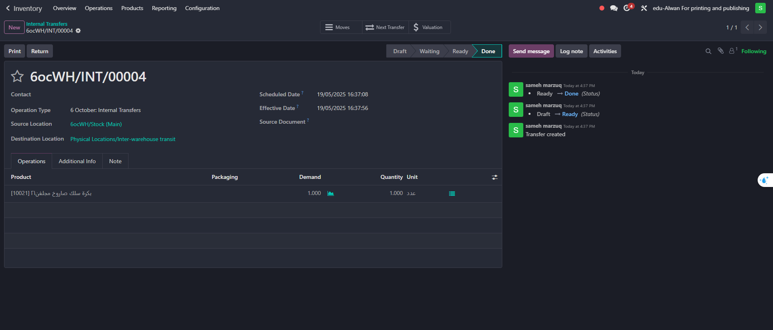
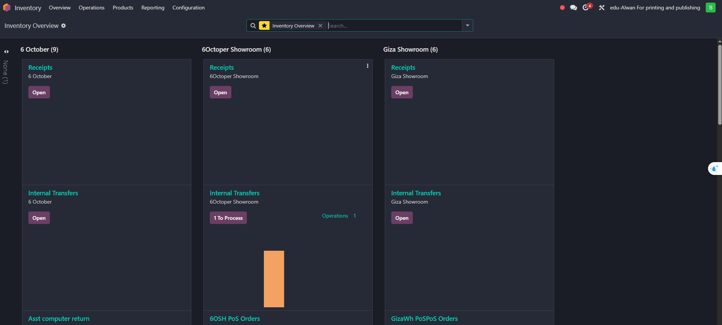
Third:
Internal
Transfer
Visibility 2

Slide 21
Third:
Internal
Transfer
Visibility 2

Slide 22
Fourth:
Scrap
Warehouse
Permission
There are no clear rules about who can approve scrap from the warehouse, which can cause mistakes and make it hard to track and recycle the scrap properly.
Proposed Solution: Let only the Warehouse Manager approve scrap actions this keeps control, reduces mistakes, and helps use scrap more efficiently to save money..

Slide 23
Fourth:
Scrap
Warehouse
Permission
There are no clear rules about who can approve scrap from the warehouse, which can cause mistakes and make it hard to track and recycle the scrap properly.
Proposed Solution: Let only the Warehouse Manager approve scrap actions this keeps control, reduces mistakes, and helps use scrap more efficiently to save money..

Slide 24
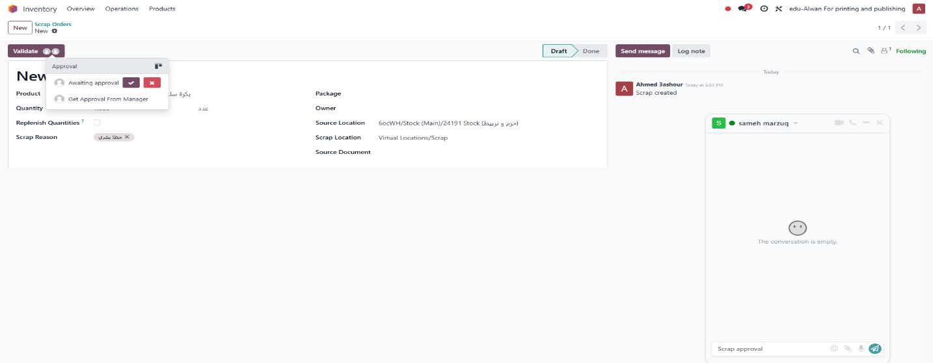
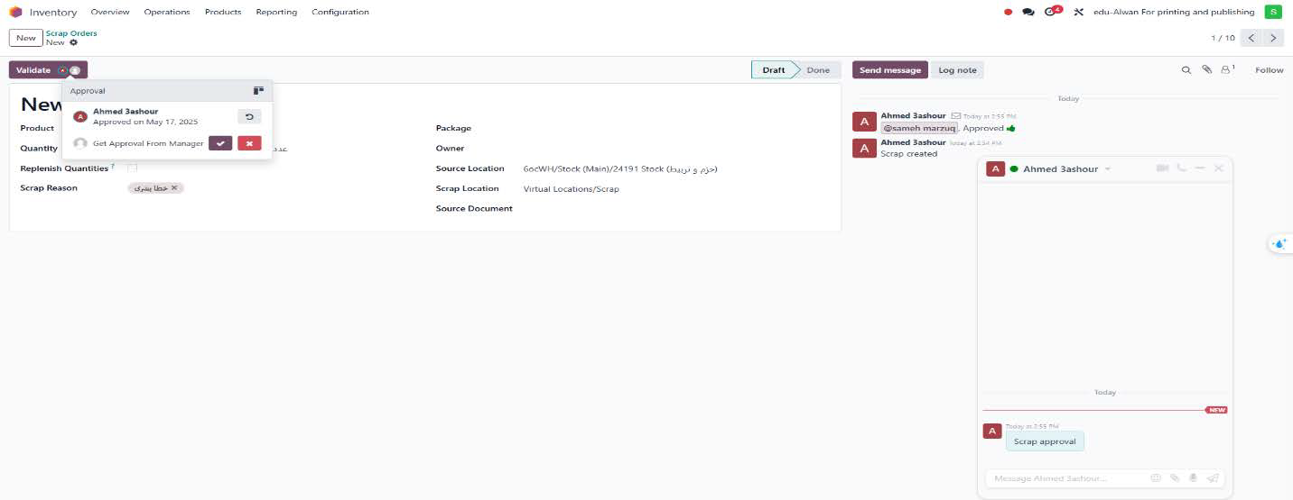
Fourth:
Scrap
Warehouse
Permission

Slide 25
Fourth:
Scrap
Warehouse
Permission

Slide 26

Fifth:
Fixed
Assets
Management
Purchase of assets (computers, printers, POS devices).
Temporary storage in warehouses to ensure continuous operations.
Automated workflow to manage issuing and reduce human errors.
Depreciation starts only after the asset is issued and used.

Slide 27
Fifth:
Fixed
Assets
Management
Purchase of assets (computers, printers, POS devices).
Temporary storage in warehouses to ensure continuous operations.
Automated workflow to manage issuing and reduce human errors.
Depreciation starts only after the asset is issued and used.

Slide 28
Fifth:
Fixed
Assets
Management 1
Proposed Solution
Show asset purchases directly in the Accounting app to track them easily.
Use serial numbers to follow each asset and check its cost through lot/serial valuation.
two operation types were created in the Inventory system to organize asset movement:
1-Asst Computer Out –When assets are issued from the warehouse.
2-Asst Computer Return –When assets are returned to the warehouse.

Slide 29
Fifth:
Fixed
Assets
Management 1
Proposed Solution
Show asset purchases directly in the Accounting app to track them easily.
Use serial numbers to follow each asset and check its cost through lot/serial valuation.
two operation types were created in the Inventory system to organize asset movement:
1-Asst Computer Out –When assets are issued from the warehouse.
2-Asst Computer Return –When assets are returned to the warehouse.

Slide 30
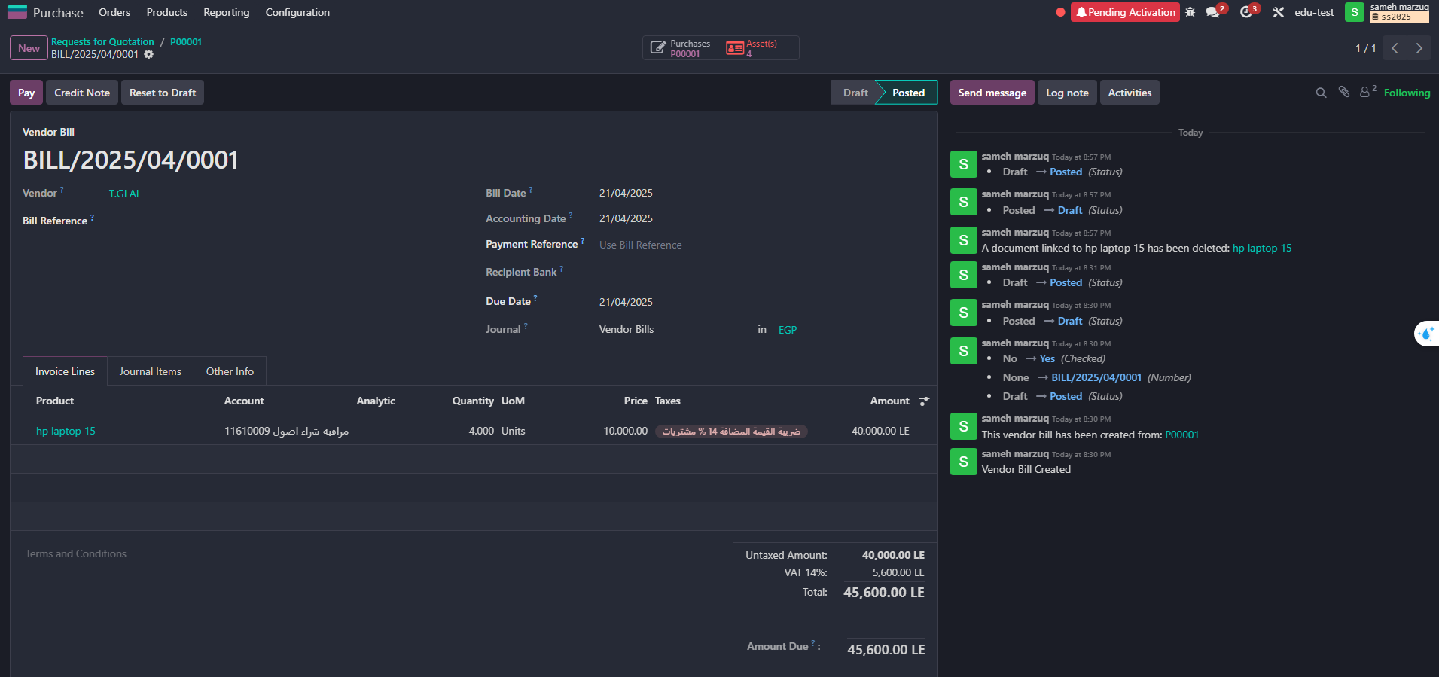
Fifth:
Fixed
Assets
Management 2

Slide 31
Fifth:
Fixed
Assets
Management 2

Slide 32
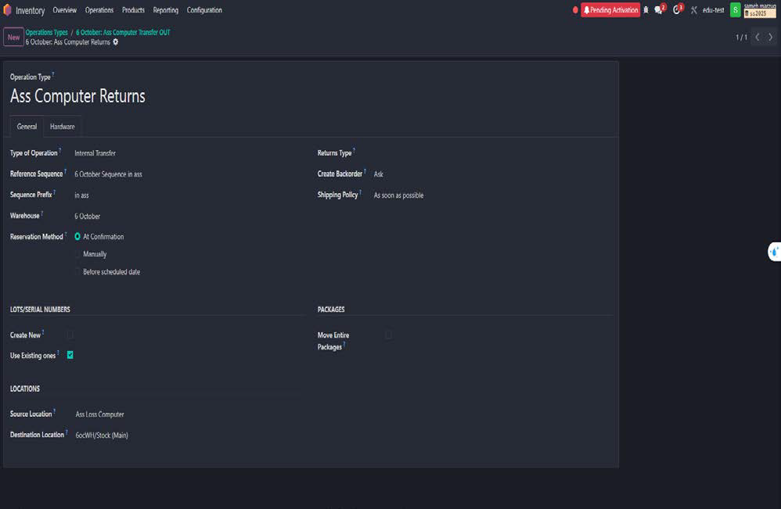
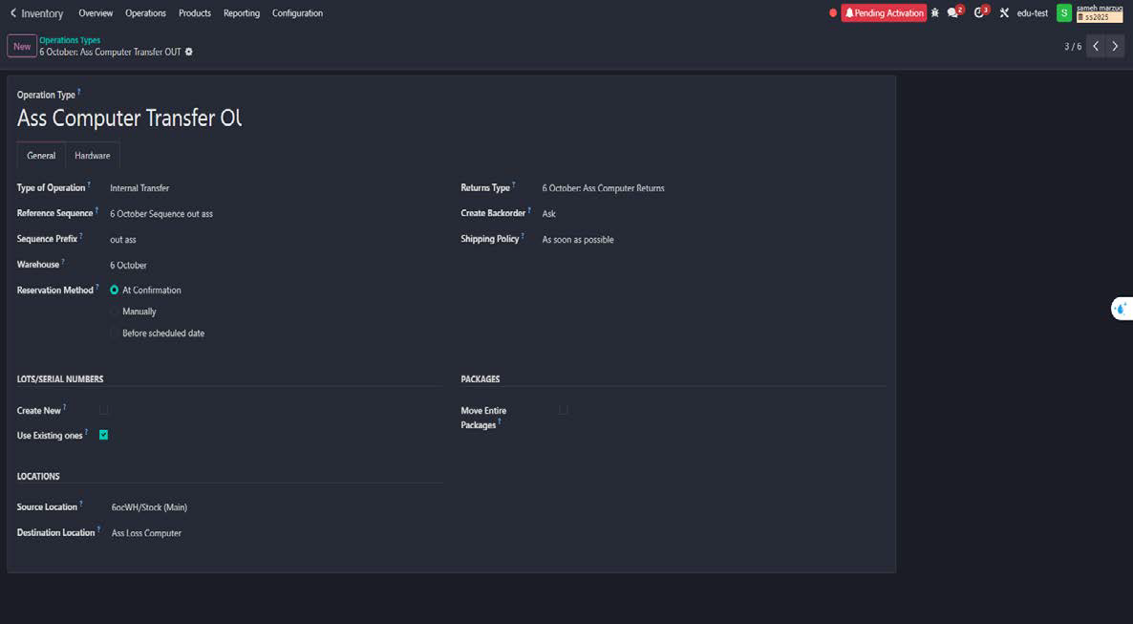
Fifth:
Fixed
Assets
Management 3

Slide 33
Fifth:
Fixed
Assets
Management 3

Slide 34
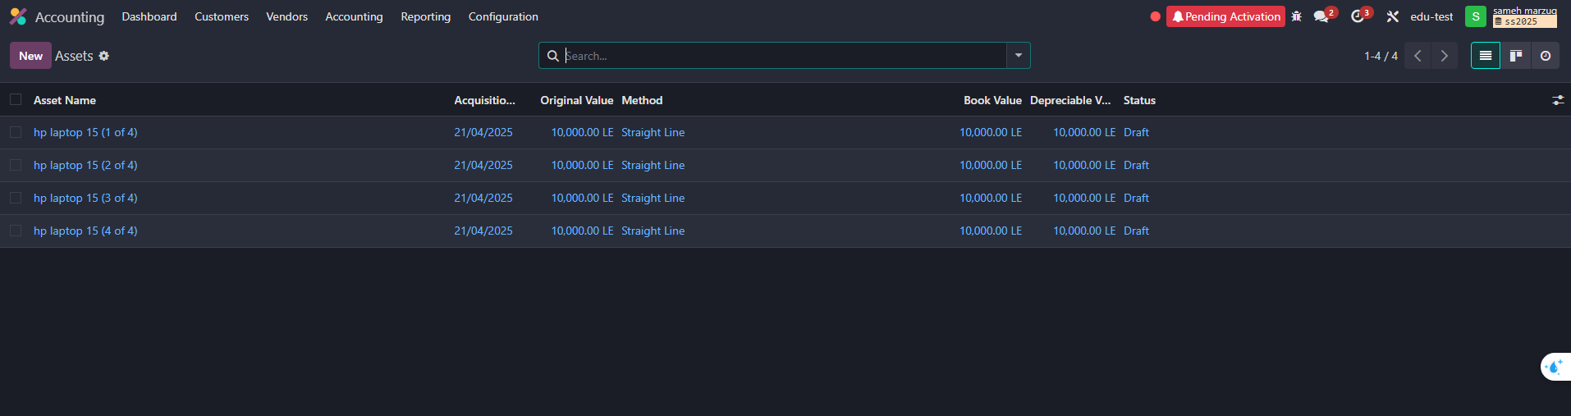
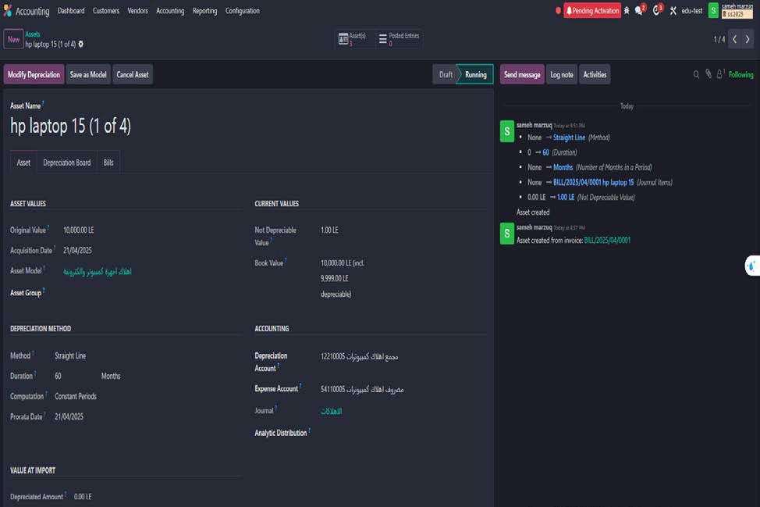
Fifth:
Fixed
Assets
Management 4
The accountant activates and starts depreciation for assets issued from the warehouse based on the warehouse release notes.

Slide 35
Fifth:
Fixed
Assets
Management 4
The accountant activates and starts depreciation for assets issued from the warehouse based on the warehouse release notes.

Slide 36
Accounting :
Chart of
Accounts
The Chart of Accounts was built based on client requirements.
Main account groups were created for structure only, while active sub-accounts are used for transactions in Odoo.

Slide 37
Accounting
: Chart of
Accounts
The Chart of Accounts was built based on client requirements.
Main account groups were created for structure only, while active sub-accounts are used for transactions in Odoo.

Slide 38
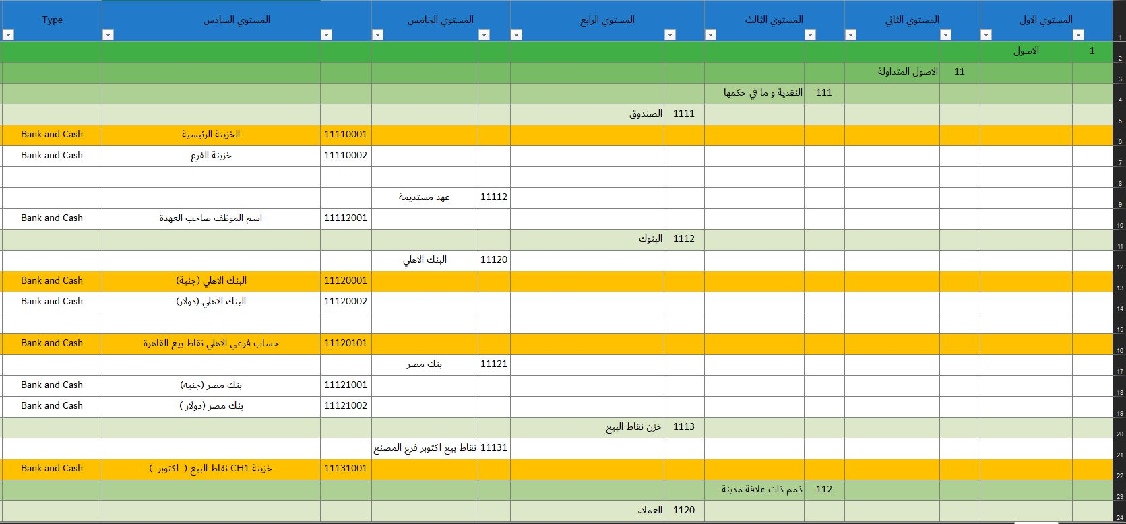
1. Chart of
Accounts
Levels:

Slide 39
1. Chart of
Accounts
Levels:

Slide 40
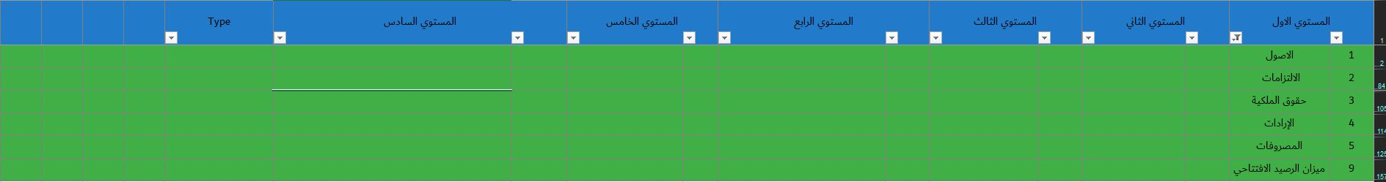
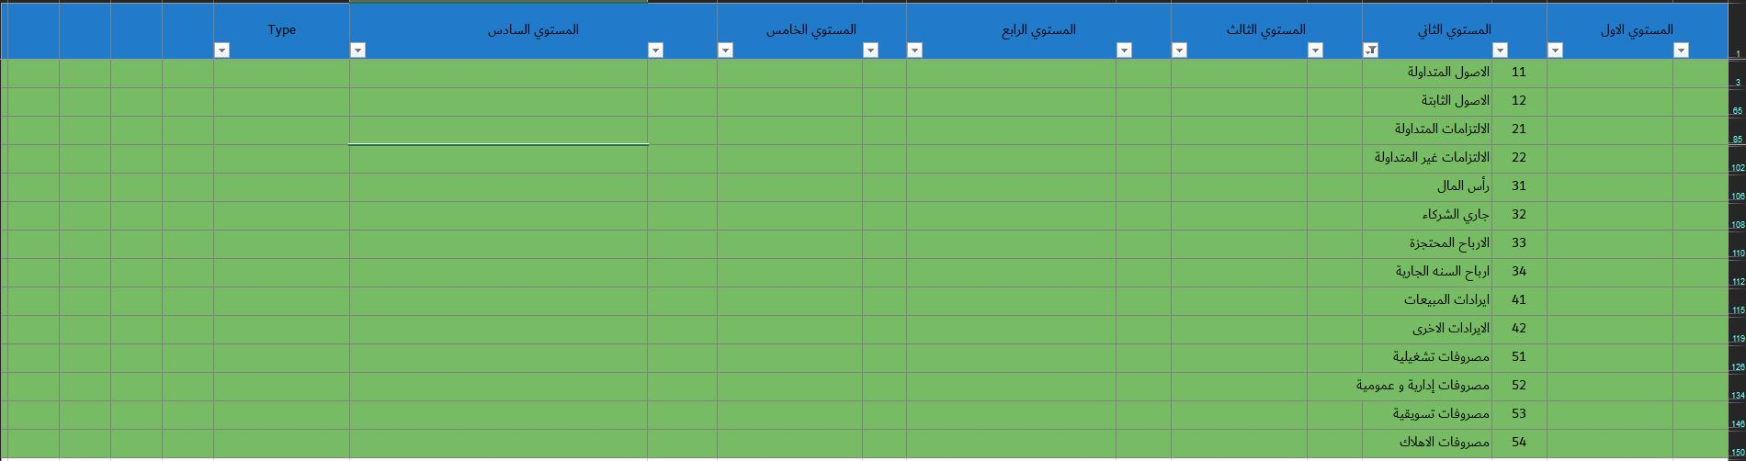
1. Chart of
Accounts
Levels:

Slide 41
1. Chart of
Accounts
Levels:

Slide 42
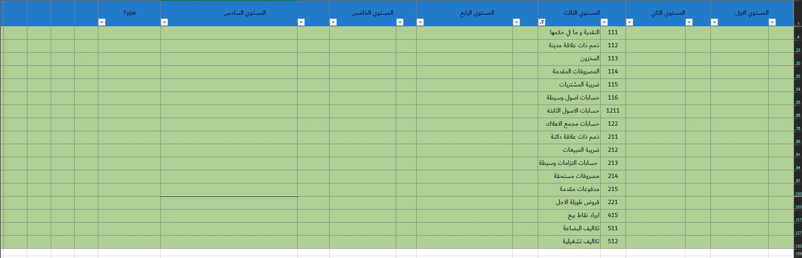
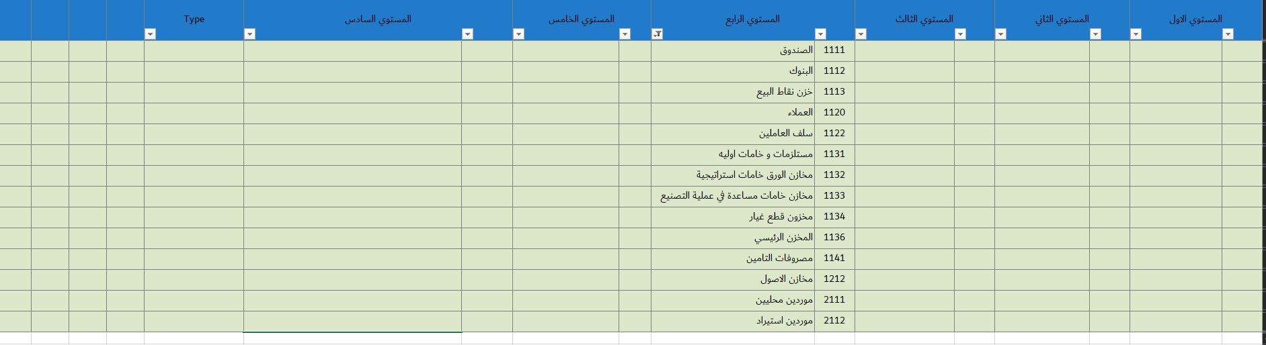
1. Chart of
Accounts
Levels:

Slide 43
1. Chart of
Accounts
Levels:

Slide 44
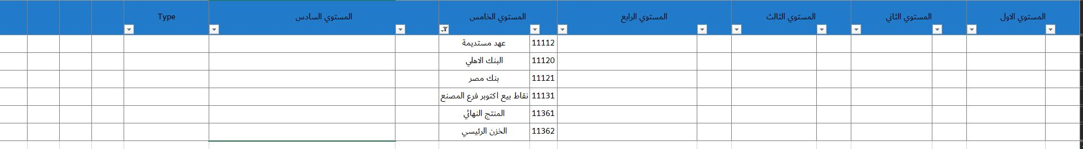
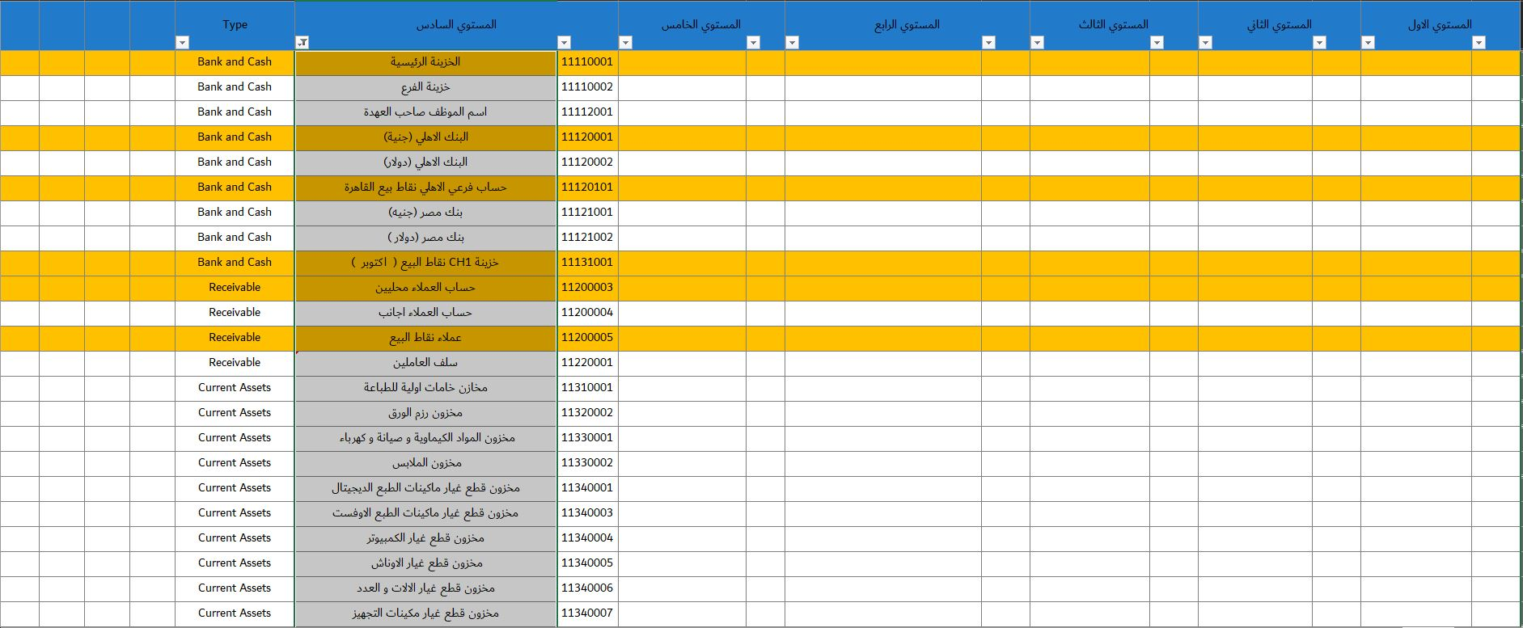
1. Chart of
Accounts
Levels:

Slide 45
1. Chart of
Accounts
Levels:

Slide 46
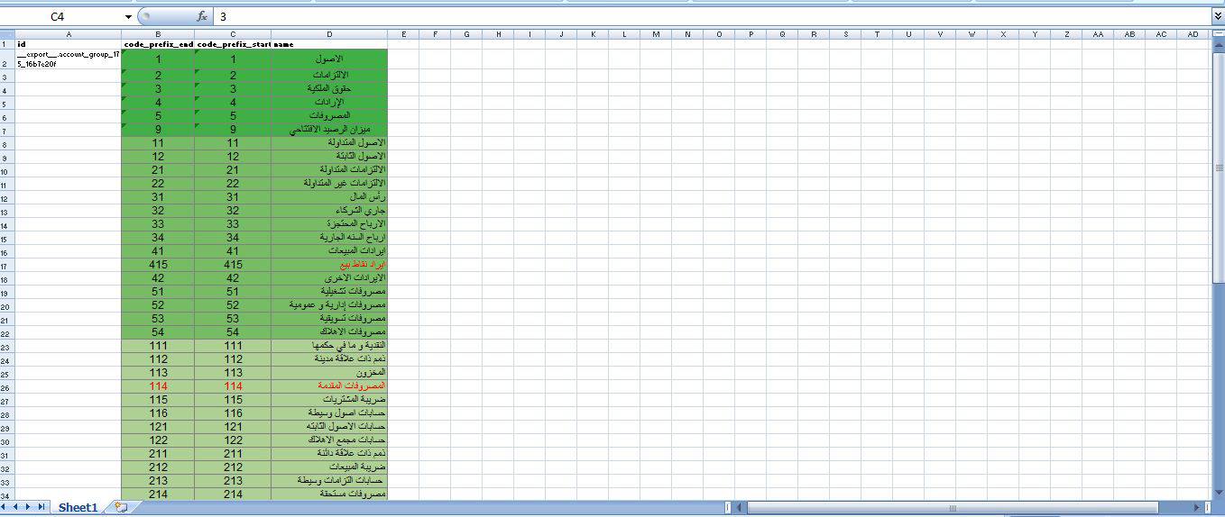
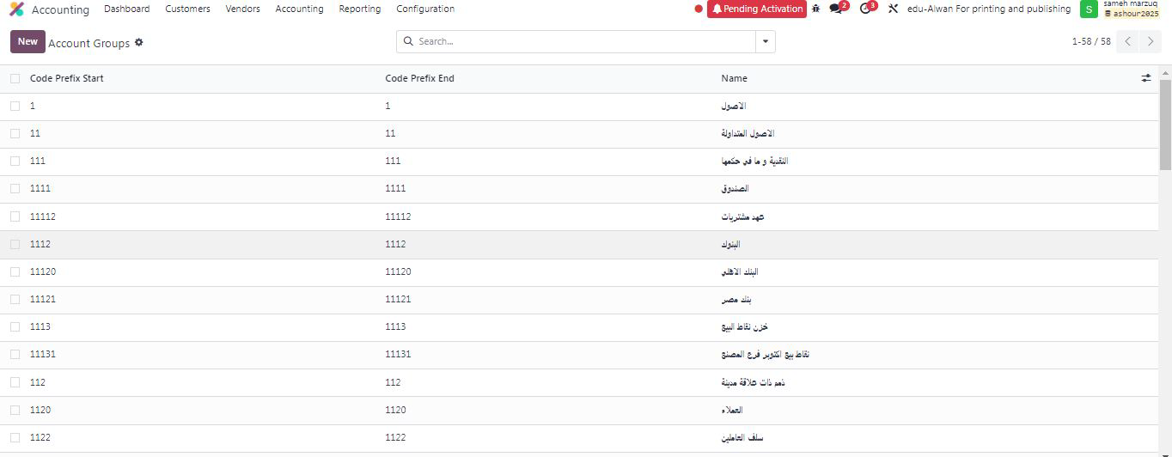
Accounts
Groups:

Slide 47
Accounts
Groups:

Slide 48
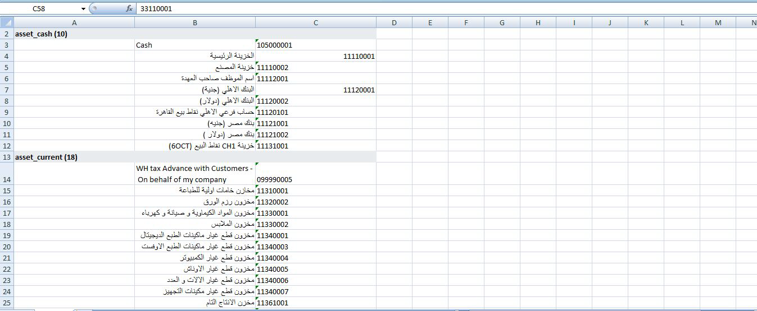
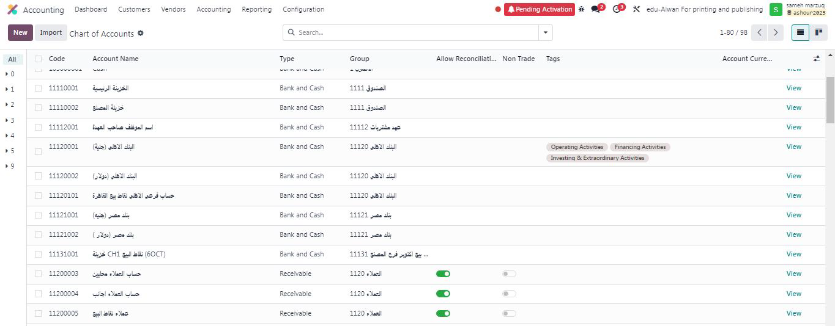
2- Charts
of Accounts :

Slide 49
2- Charts
of Accounts :

Slide 50
Accounting :
Asset
Creation

Slide 51
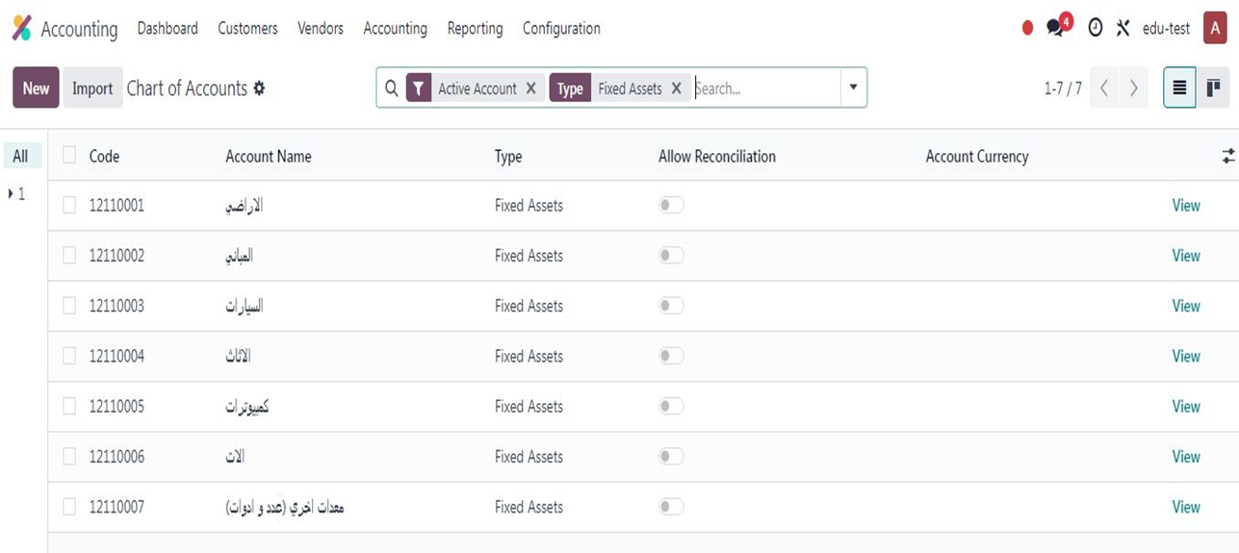
Accounting :
Asset
Creation
1- A group of asset accounts was created in the printing press chart of accounts (Fixed Assets), including 7 accounts:

Slide 52
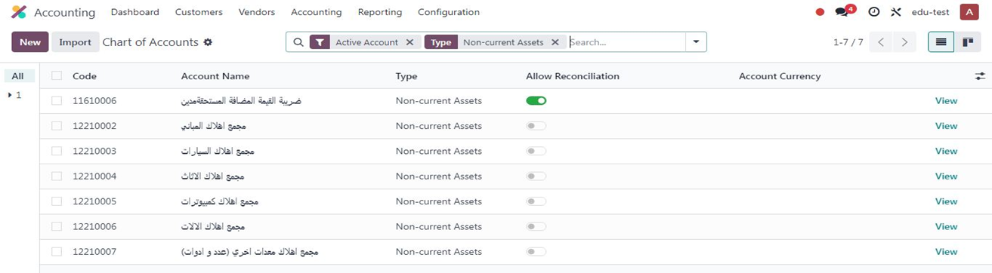
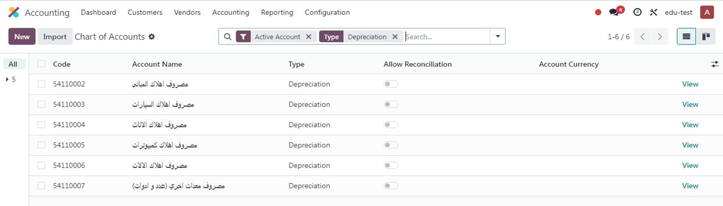
2- A group of accumulated depreciation accounts was created in the chart of accounts, including 6 accounts:
3- A group of depreciation expense accounts was created for the current accounting period, including 6 accounts:

Slide 53
2- A group of accumulated depreciation accounts was created in the chart of accounts, including 6 accounts:
3- A group of depreciation expense accounts was created for the current accounting period, including 6 accounts:

Slide 54
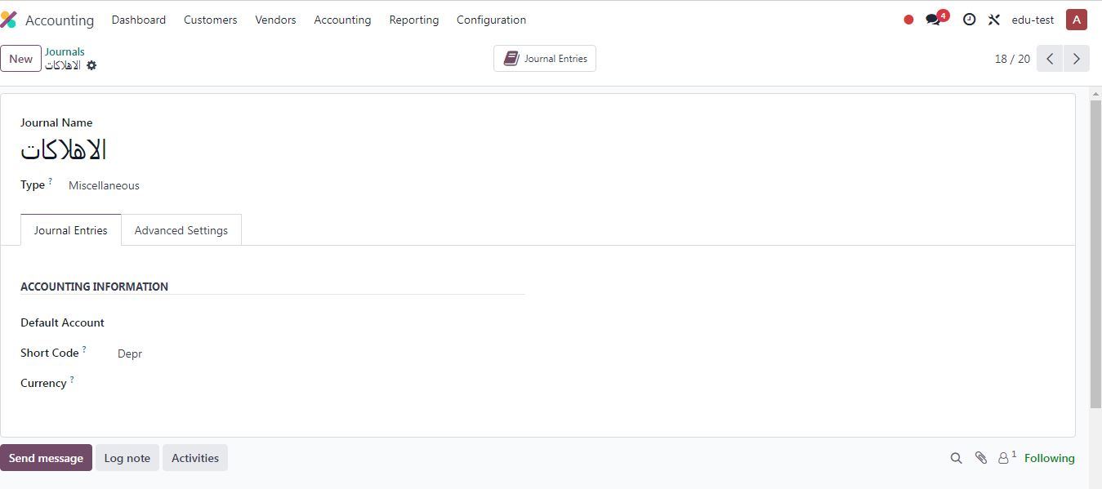
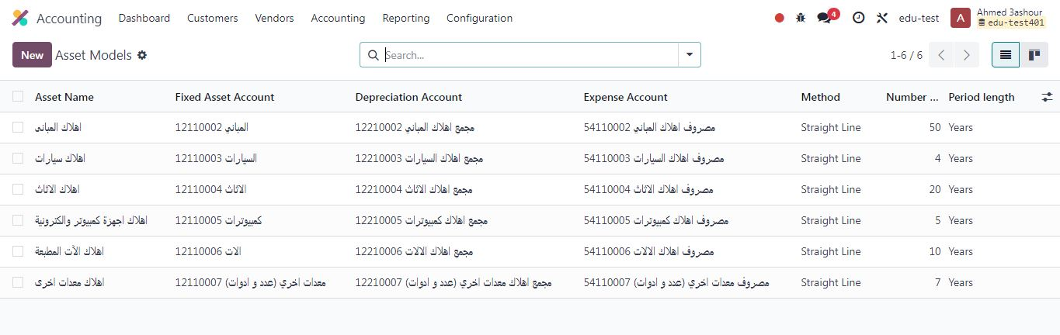
4- A special depreciation journal was created (short name: Depr):
5- Asset models were created for each account separately based on its depreciation rate, linked to asset accounts, accumulated depreciation accounts, and expense accounts:

Slide 55
4- A special depreciation journal was created (short name: Depr):
5- Asset models were created for each account separately based on its depreciation rate, linked to asset accounts, accumulated depreciation accounts, and expense accounts:

Slide 56
Inventory
It is an integrated ERP system that provides a powerful inventory management module that helps track materials and goods in real time.
The module is linked to purchasing, manufacturing, sales, and accounting modules, creating an integrated workflow.
It is based on the principle of "fully automated control of material flow."

Slide 57
Inventory
It is an integrated ERP system that provides a powerful inventory management module that helps track materials and goods in real time.
The module is linked to purchasing, manufacturing, sales, and accounting modules, creating an integrated workflow.
It is based on the principle of "fully automated control of material flow."

Slide 58
Purchase
helps companies manage supplier purchases efficiently, from creating purchase requests to receiving and paying bills

Slide 59
Purchase
helps companies manage supplier purchases efficiently, from creating purchase requests to receiving and paying bills

Slide 60
Sales
Introduction to the Sales App in Odoo
The Sales app in Odoo is a powerful tool for managing the entire sales process, from quotations to invoices. It offers an easy-to-use interface and a set of features designed to streamline the sales process and enhance efficiency.

Slide 61
Sales
Introduction to the Sales App in Odoo
The Sales app in Odoo is a powerful tool for managing the entire sales process, from quotations to invoices. It offers an easy-to-use interface and a set of features designed to streamline the sales process and enhance efficiency.

Slide 62
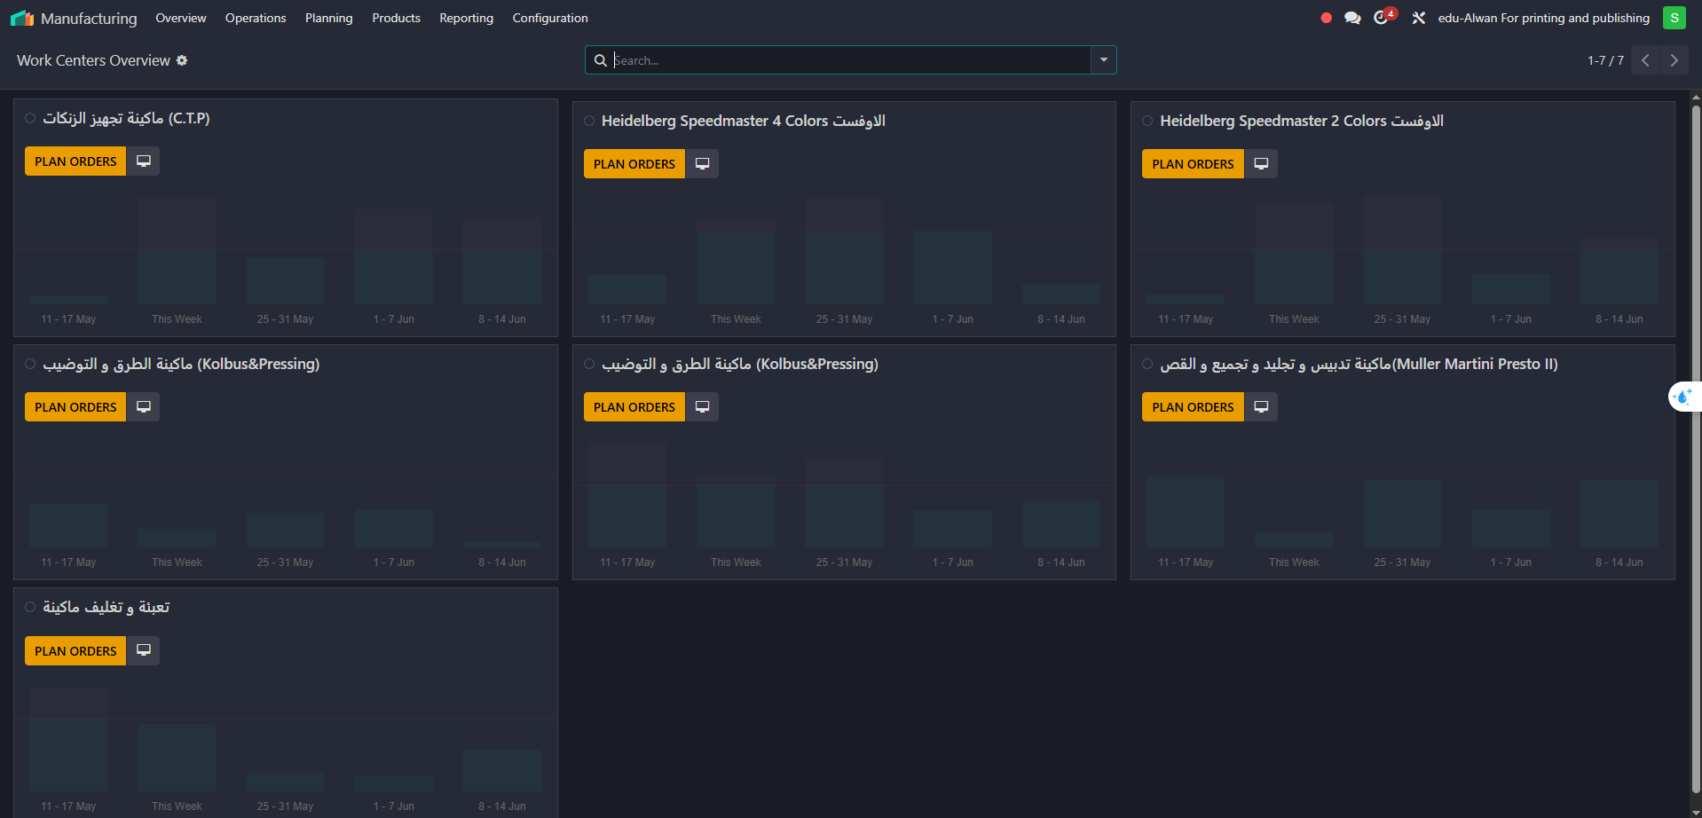
Manufacturing
It was used to organize production operations.
Coordination was done with production and quality engineers to define raw material usage for each product based on customer orders.
Calculations were made in Excel, and the results were added to Odoo as Bills of Materials (BOMs) to ensure production accuracy.

Slide 63
Manufacturing
It was used to organize production operations.
Coordination was done with production and quality engineers to define raw material usage for each product based on customer orders.
Calculations were made in Excel, and the results were added to Odoo as Bills of Materials (BOMs) to ensure production accuracy.

Slide 64
Point
of Sale
(POS)

Slide 65
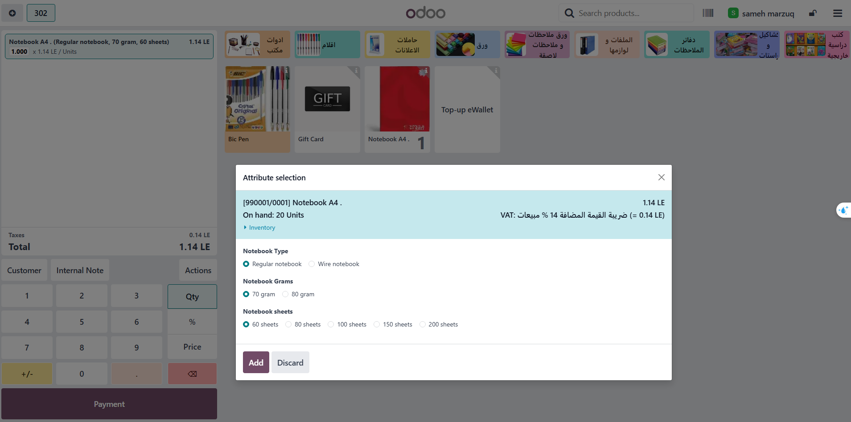
Point
of Sale
(POS)
Objective: Streamline sales processes in bookstores while automatically integrating them with
the rest of the system (purchasing, inventory, accounting, sales, manufacturing).
Key Features:
Quick sales without the need to manually create an invoice.
Complex sales support (print adjustments during sales, adding additional services)

Slide 66
Conclusion
this project represents a practical step towards digitizing and efficiently managing printing operations using Odoo. Gaps were analyzed and custom solutions implemented to meet the client's needs. We hope this work serves as a valuable milestone in our professional journey.

Slide 67
Conclusion
this project represents a practical step towards digitizing and efficiently managing printing operations using Odoo. Gaps were analyzed and custom solutions implemented to meet the client's needs. We hope this work serves as a valuable milestone in our professional journey.

